Slide 1
Happy Customers Final Report
Apziva Project 1
By: Sophia Wagner

Slide 2
Project Goal: Predict if a customer is happy or not based on the answers they give to the questions asked

Slide 3
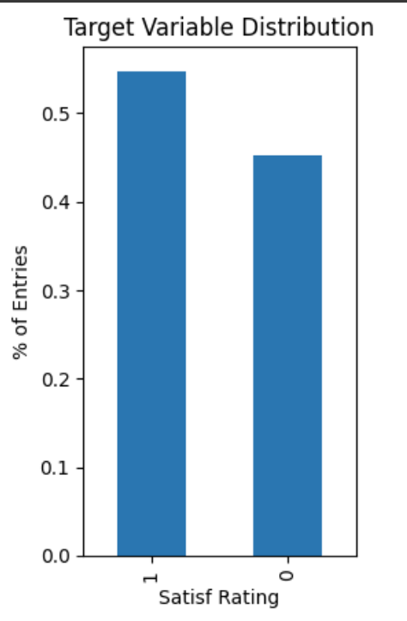
Look at the Data
 | Average | Standard Deviation
X1 | 4.33 | 0.08
X2 | 2.53 | 1.11
X3 | 3.31 | 1.02
X4 | 3.75 | 0.88
X5 | 3.65 | 1.15
X6 | 4.25 | 0.81

Slide 4
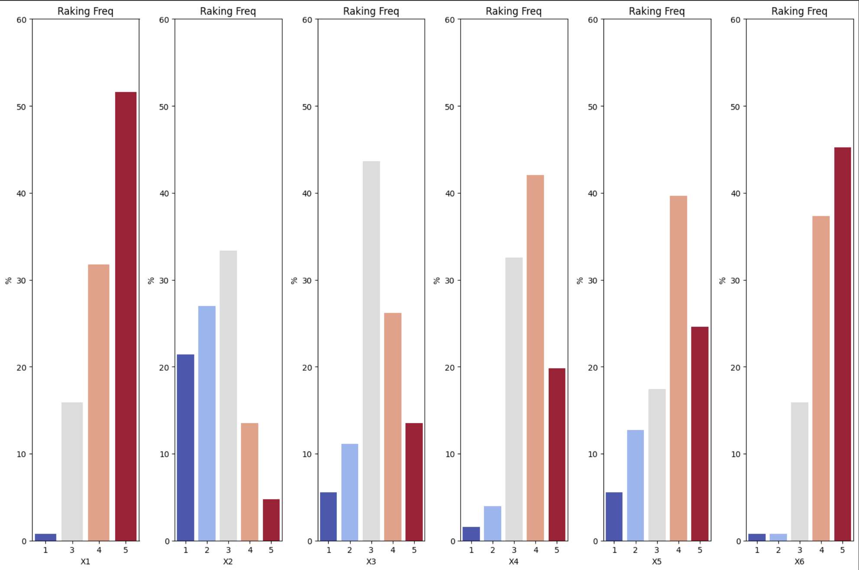
Look at the Data
The features are not linearly independent
Multicollinearity was found to be present between the features of the dataset
From this 3 models were compared:
Logistic Regression
Random Forest Classifier
Stochastic Gradient Descent Classifier

Slide 5
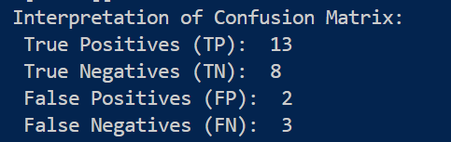
The Model
Model Type: Random Forest Classifier
Implemented using Python’s Sklearn with a 80%/20% train-test split
Features Used in the model:
X1: my order was delivered on time
X3: I ordered everything I wanted to order
X6: the app makes ordering easy for me
Model Performance: 80.77%
Unhappy Class Precision: 73%
Happy Class Precision: 87%

Slide 6
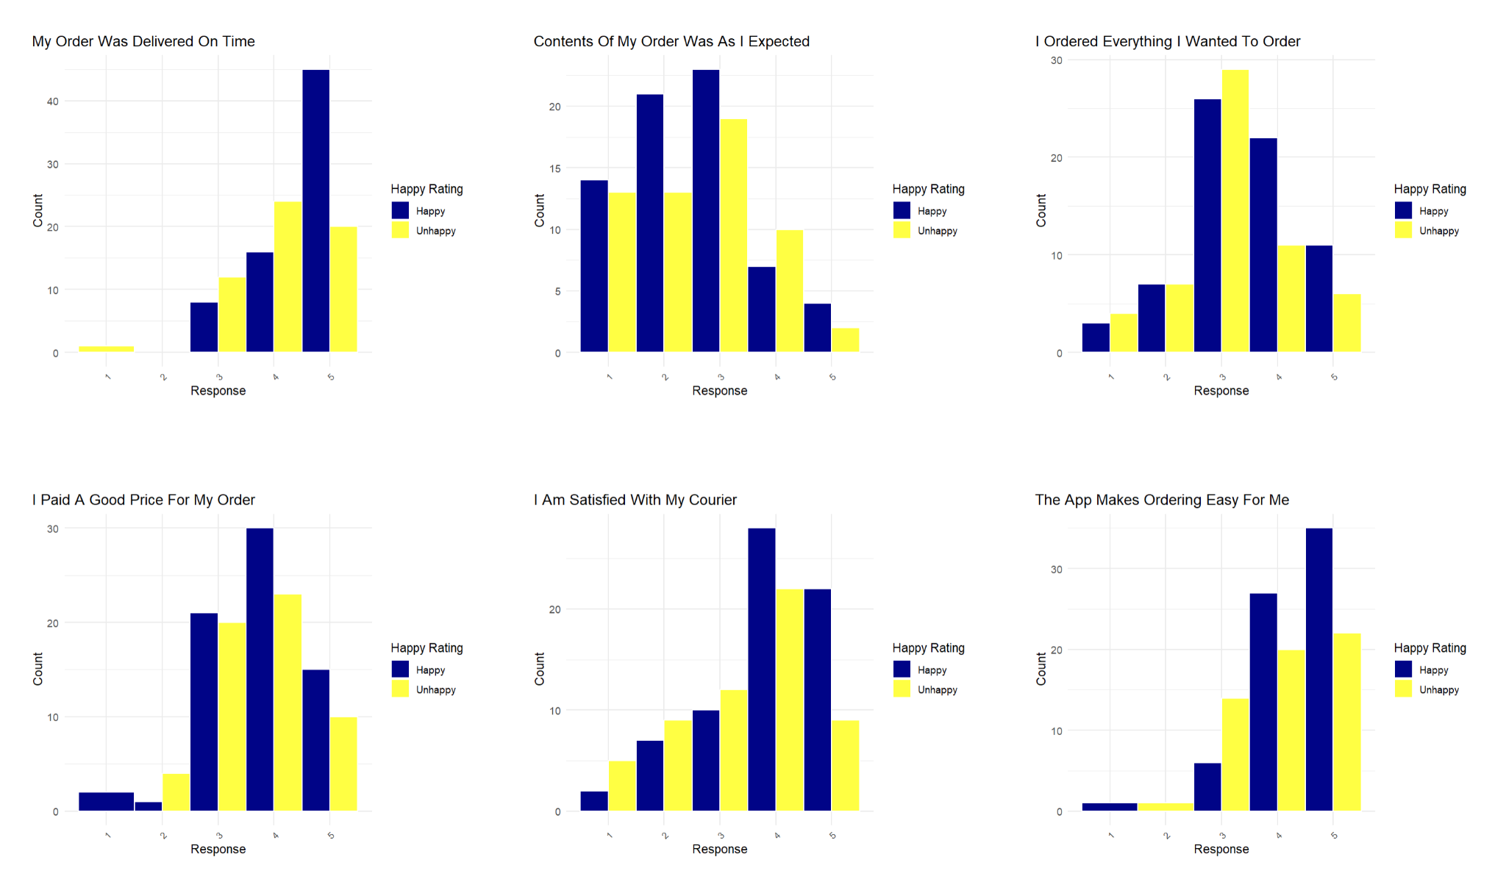
Suggestions for Future Surveys
Questions I recommend removing from the next survey:
- “Contents of my order was as I expected”
- “I paid a good price for my order”

Slide 7
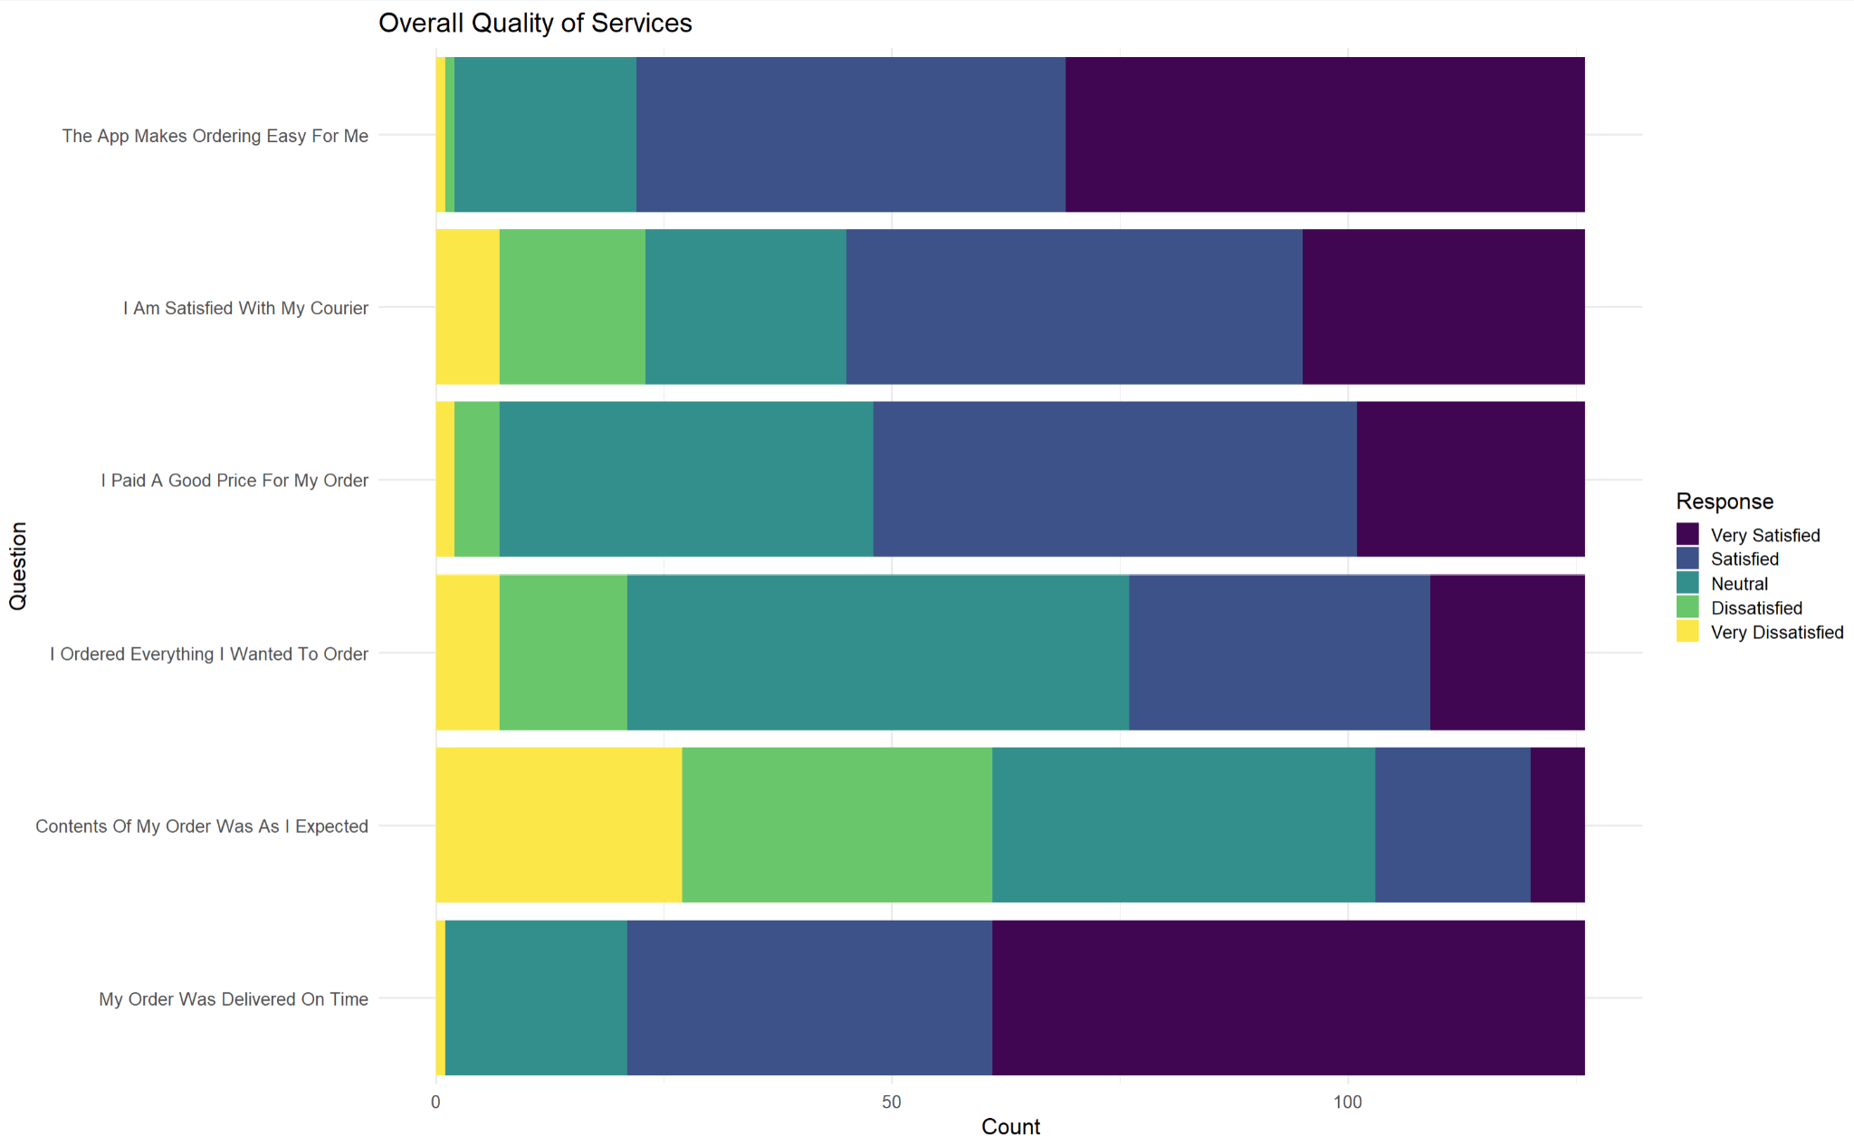
Final Survey Suggestion
I would strongly encourage reworking the wording of question X2 to be more like "Contents of my order met or exceeded my expectations"
- Comparing the Likert scale graph and the colored bar graph a larger number of customers are giving a 1-3 rating for X2 but most of those customers are being labeled as "happy" in the colored bar graph
- A possible example to consider for the benefit of rewriting the question is the scenario where a customer orders 1 item and they recieve 2 pieces of the item. When answering the question "Contents of my order were as I expected" the customer could likely answer 'No' because they only ordered 1 item but received 2. However, the customer could be a Happy customer!
Therefore, rewording the question like the suggestion above could lead to a better understanding/representation of the customer's experience

